Slide 1

Improving Driver Safety by Detecting and Reducing Health Risks in Vehicles Using Sensors
Team
Saragadam Charishma (21NM1A04D3)
S.V.L Meghana (21NM1A04E0)
M.Preethi (22NM5A0427)
T.SRK Teja Sree (21NM1A04E7)
Project Guide
Mr. B. Hari Kumar
Assistant Professor
Department of Electronics and Communication Engineering
Vignan’s Institute of Engineering for Women
Affiliated to JNTUGV, Visakhapatnam,
Andhra Pradesh – 530049.

Slide 2
Contents
Introduction
Literature Survey
Objectives
Method & Methodology
Implementation
Frame Work
Project Overview
References

Slide 3
Introduction
Our project,“Improving Driver Safety by Detecting and Reducing Health Risks in Vehicles Using Sensors introduces innovative sensor technology to monitor the issues.
It includes a heart rate sensor and an eye blinking sensor above the driver's eyes, ensuring continuous vital sign monitoring.
The alarm system alerts the driver with buzzers and calls emergency services if conditions worsen.
The system slows the vehicle, enhancing safety, preventing accidents from drowsiness or health issues, and enabling assistance.

Slide 4
Literature Survey
SNO. | Project Title | Publishing Year& journal name | Observation Made | Limitations
1. | Video-Based Driver Drowsiness Detection With Optimized Utilization of Key Facial Features | 2024(IEEE Transactions on Intelligent Transportation Systems) | High accuracy, reduced computation, lower false positives, real-time alerts, lighting sensitivity, camera dependency | Limitations include sensitivity to lighting changes, head moments and affecting detection accuracy and real-time performance.
2. | Driver Fatigue Detection Method Based on Eye States With Pupil and Iris Segmentation | 2020 (IEEE Access) | High accuracy, reliable blink analysis, reduced false positives, real-time efficiency, lighting sensitivity. | The study is limited by sensitivity to light , camera quality, individual variations in eye features and causing the potential detection error.

Slide 5
Literature Survey
SNO | Project Title | Publishing Year & journal name | Observation Made | Limitations
3. | Design and Implementation of a Drowsiness-Fatigue Detection System Based on Wearable Smart Glasses to Increase Road Safety | 2018 (IEEE Transactions on Consumer Electronics) | Smart glasses enabled non-intrusive monitoring, IR sensor improved accuracy, real-time alerts reduced reaction time, remote monitoring, and users found them comfortable | Environmental sensitivity, battery life, user discomfort, false detections, privacy concerns, connectivity issues, high cost, and adaptation challenges.
4. | An Automatic Driver Drowsiness Alert System By Using GSM | 2017 ( IEEE Conference on 11th ISCO) | The system detects drowsiness, triggers alerts, transmits GSM messages reliably, and ensures cost-effective deployment. | The system lacks GPS, may face GSM issues in weak networks, and risks false positives under poor lighting.

Slide 6
Objectives
The Objective of our project is:
To continuously monitor vital signs (heart rate and eye blinking) using seatbelt and eye sensors.
To create an intelligent alarm system for potential danger alerts.
To enable automated emergency calls for deteriorating driver conditions, enhancing road safety.

Slide 7
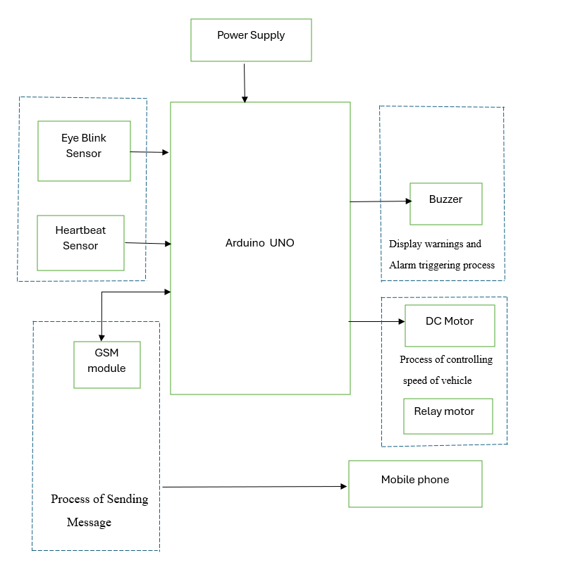
BLOCK DIAGRAM

Slide 8
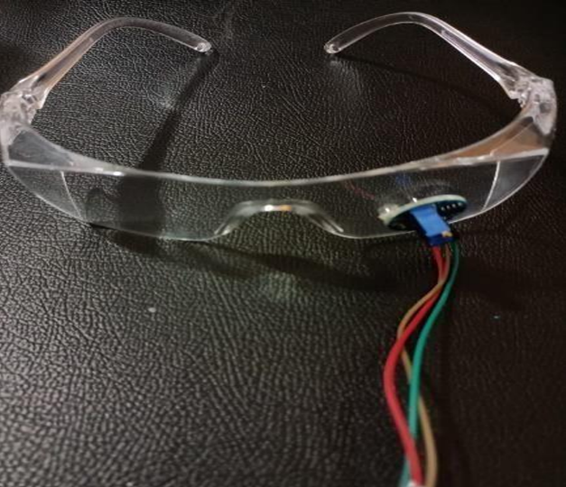
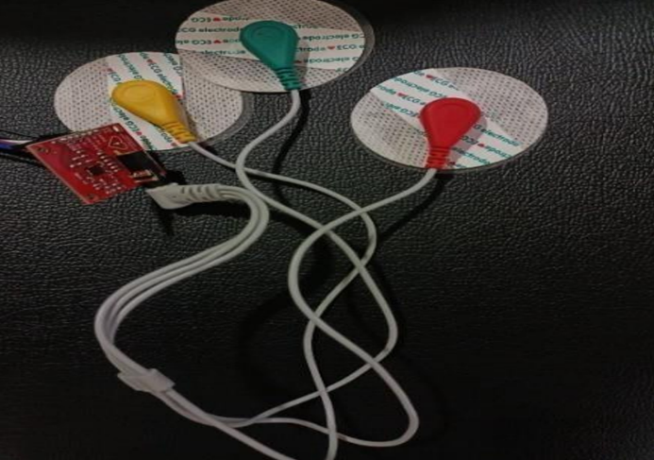
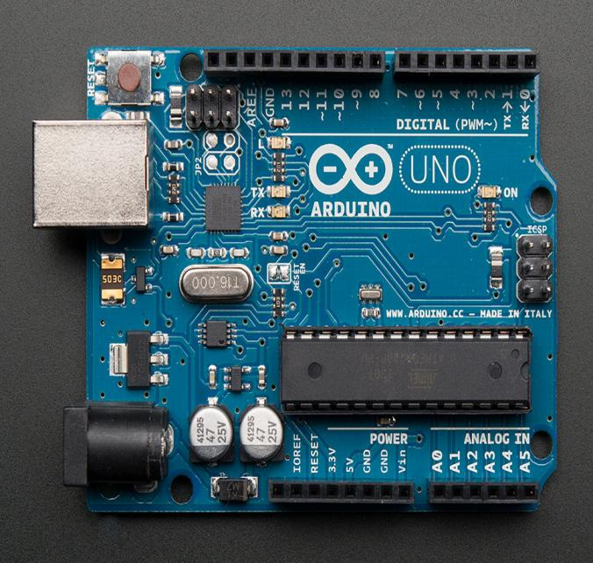
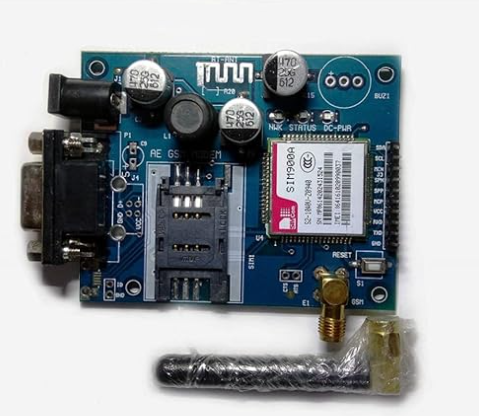
Components used
Eye blinking sensor
Heartbeat sensor
Arduino uno
GSM Module

Slide 9
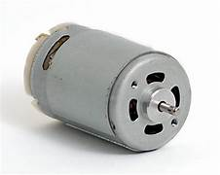
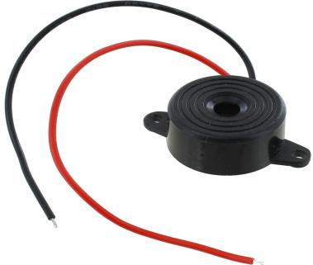
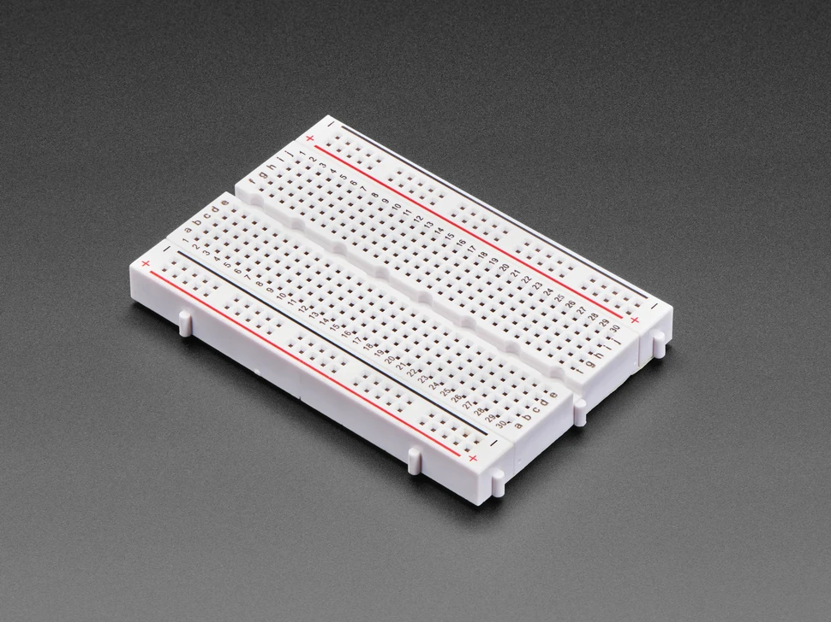
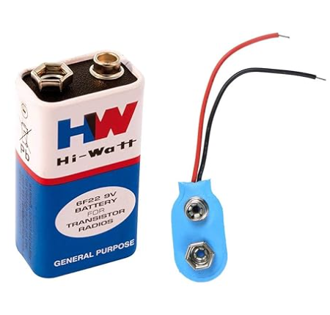
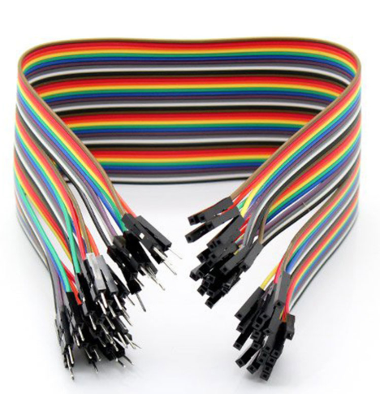
DC Motor
Buzzer
Breadboard
Battery
Jumper cables

Slide 10
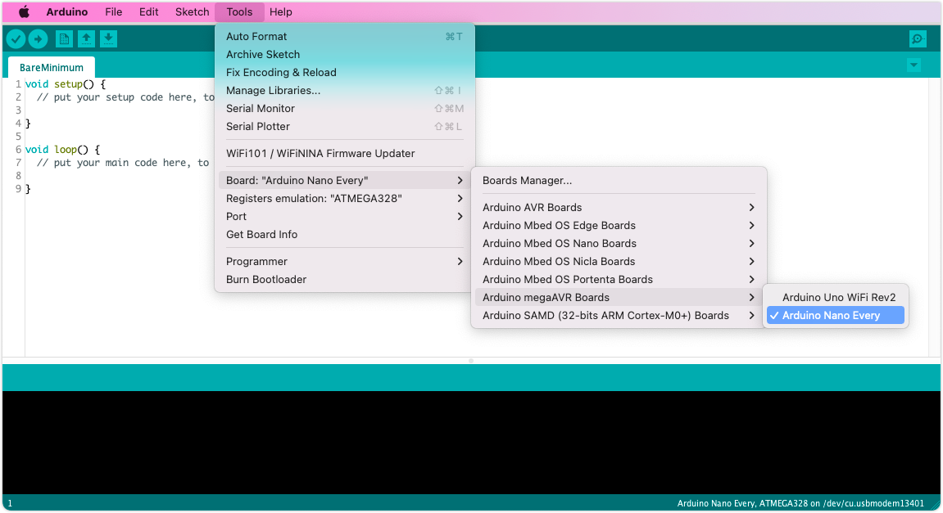
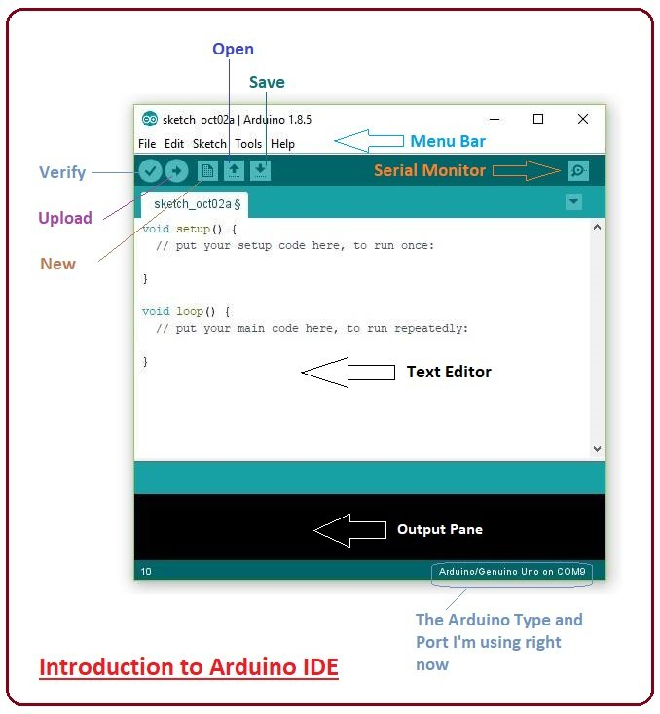
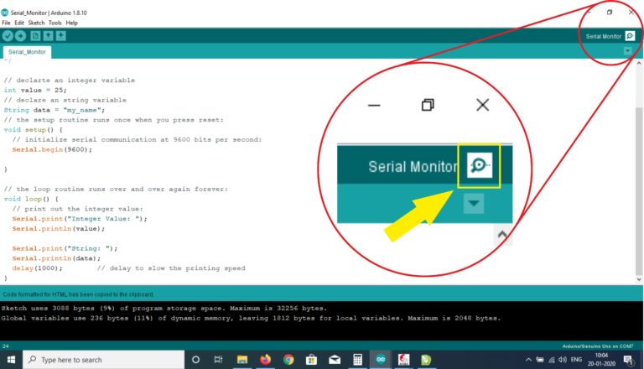
Software used
Arduino IDE

Slide 11
Method & Methodology
Our methodology is centered on a careful process to elevate driver safety. Commencing with sensor activation, our system engages in parallel processes for eye blinking and heart rate counting.
The project unfolds through five distinct phases, which illustrates the stages of Drowsiness and Heart Attack Detection.
Data collection
Collection of drowsiness
Heart rate detection
Speed reduction of vehicle and Emergency alert
Action taken

Slide 12
Method & Methodology
START
Sensors activated
Process of counting eye blinking rate
Process of counting
Hearbeat rate
Drowsiness and heart
rate detection
Process of controlling
vehicle speed
Protocol of transmitting emergency notifications
Action taken by
the system
SSTOP

Slide 13
Implementation
Detecting drowsiness by counting eye blinks
The eye blink sensor captures proximity data every 5 seconds to detect the driver's eye state (open or closed).
Condition 1 (Less Drowsy - Awake): Proximity between 3.00 and 4.00 triggers a 4-second audible warning.
Condition 2 (Drowsy): Proximity between 1.00 and 1.90 triggers a continuous buzzer.
Condition 3 (Sleepy): Proximity remains in the drowsy range, activating vehicle speed control to prevent accidents.
Detecting pulse rate through heartbeat sensor
Alarms activate for high heartbeat rates, providing warnings and alerts for potential health issues or stress.

Slide 14
Implementation
Ignition Lock Control
When a sleepy condition is detected, the vehicle gradually reduces its speed every 4 seconds until it comes to a complete stop at 0 km/h.
This controlled deceleration prevents sudden braking, which could cause dangerous collisions.
It also alerts nearby drivers, giving them enough time to react and avoid potential accidents by maintaining situational awareness.
Sending Notification
When the vehicle halts, the GPS module determines its exact location, while the GSM module sends a message about the driver’s condition and location to family or friends for immediate awareness.

Slide 15
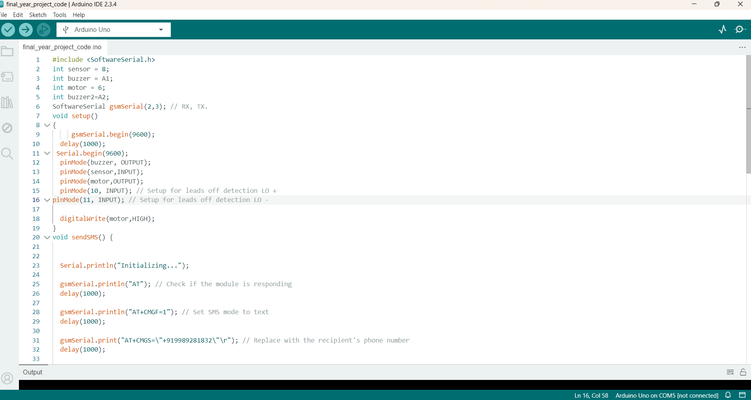
arduino ide software

Slide 16
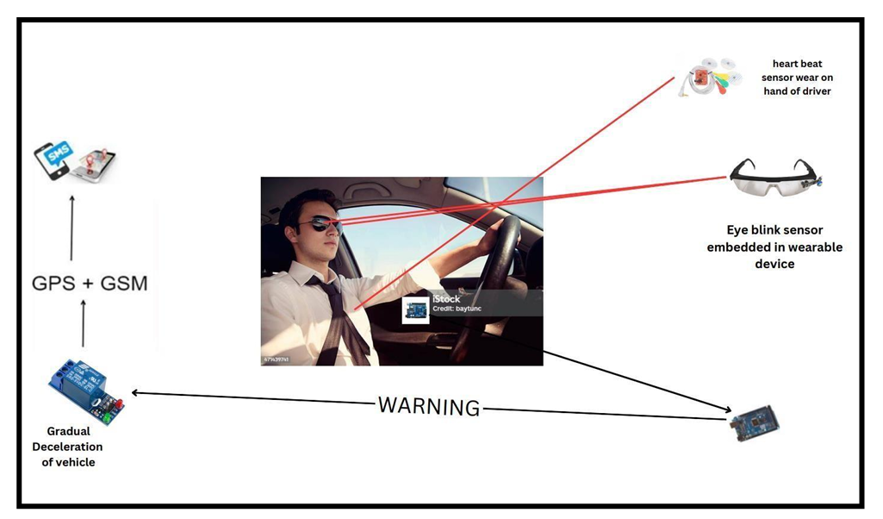
Frame Work
system architecture

Slide 17
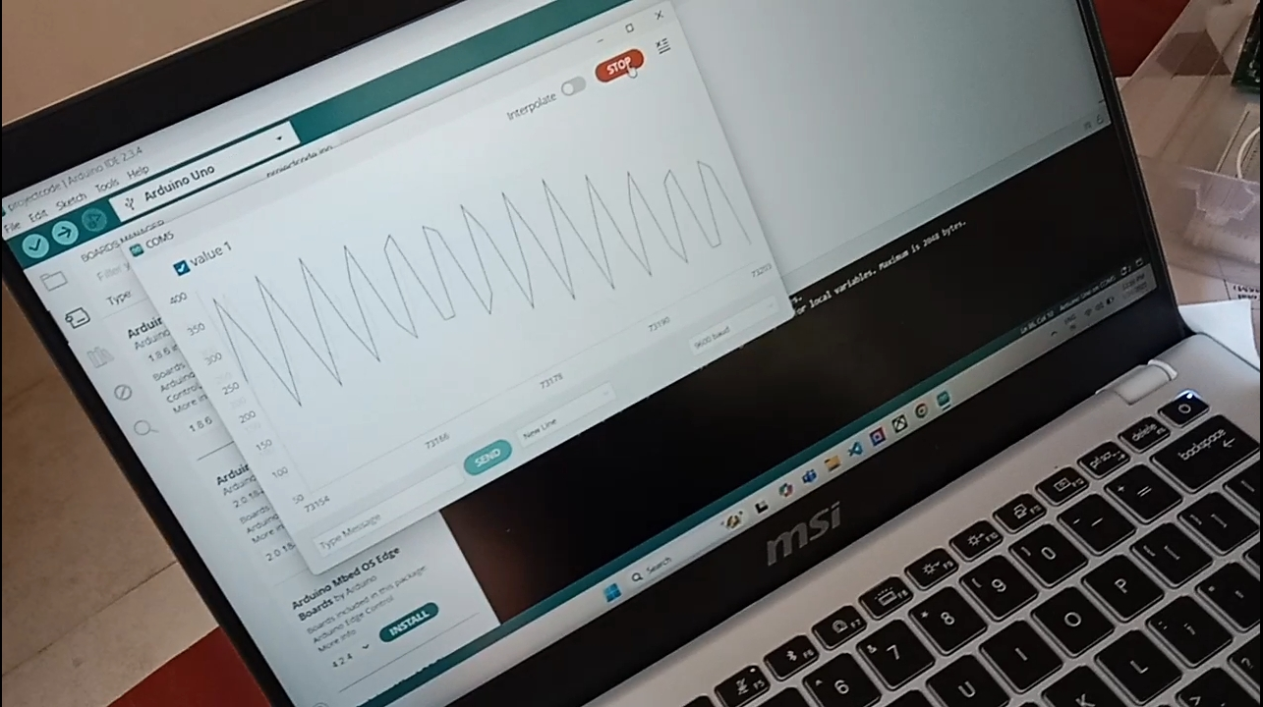
Result

Slide 18
Project Overview
The system uses components like Arduino Uno, GSM, and GPS modules, integrating real-time health monitoring sensors for proactive safety measures.
The system integrates heart rate and eye-blinking sensors to monitor driver health, issuing alerts for drowsiness or emergencies.
The system issues alerts through intelligent alarms when signs of drowsiness or health risks are detected.
In critical cases, it activates gradual vehicle deceleration and sends emergency notifications with GPS coordinates to designated contacts.
This comprehensive solution prioritizes driver safety, reduces accidents caused by health emergencies, and offers timely intervention, contributing to safer transportation systems.

Slide 19
Project Overview
Pros of the solution
Improved Driver Safety.
Early Warning System.
Automated Emergency Response.
Gradual Deceleration.
Promotes Road Safety.
Reputation Enhancement for Manufacturers.
Cons of the solution
Technical Limitations.
Problem arises in low network areas.

Slide 20

PAPER ACCEPTANCE

Slide 21
References
NIOSH|CDC,“Module11.Driving,drowsydriving|NIOSH|CDC,”Mar.31,2020, Accessed: Jan. 24, 2023, [Online]. Available: https://www.cdc.gov/niosh/work hour-training-for-nurses/longhours/mod11/02.html
A. Gross, G. Li, C. DiGuiseppi, J. S. Zakrajsek, T. J. Mielenz, and D. Strogatz, “Advanced driver assistance systems and older drivers: Changes in prevalence, use, and perceptions over 3 years of the AAA LongROAD study- AAA Foundation for traffic safety,” AAA Foundation for Traffic Safety, Dec. 17, 2021, Accessed: Jan. 24, 2023, [Online]. Available: https://aaafoundation.org/advanced-driver-assistance systems-and-older-drivers-changes-in-prevalence-use-and-perceptions-over-3 years-of-the-aaa-longroad-study/
National Safety Council, “Fatigued driving,” Accessed: Jan. 24, 2023, [Online]. Available: https://www.nsc.org/road/safety-topics/fatigued-driver

Slide 22
References
Q. Zheng et al., “A texture-aware U-Net for identifying incomplete blinking from eye videography,” Biomed. Signal Process. Control, vol. 75, 2022, Art. no. 103630, doi:10.1016/j.bspc.2022.103630.
C. B. S. Maior et al., “Real-time classification for autonomous drowsiness detec tion using eye aspect ratio,” Expert Syst. Appl., vol. 158, 2020, Art. no. 113505, doi: 10.1016/j.eswa.2020.113505.
C. Lee and J. An, “LSTM-CNN model of drowsiness detection from multi ple consciousness states acquired by EEG,” Expert Syst. Appl., vol. 213, 2023, Art. no. 119032, doi: 10.1016/j.eswa.2022.119032.
M. Zaidman, C. B. Novak, G. H. Borschel, K. Joachim, and R. M. Zuker, “Assess ment of eye closure and blink with facial palsy: A systematic literature review,” J. Plast., Reconstructive Aesthetic Surg., vol. 74, no. 7, 2021, pp. 1436–1445, doi: 10.1016/j.bjps.2021.03.059.

Slide 23
References
MediaPipe, “Face mesh” Accessed: Dec. 24, 2022, [Online]. Available: https: //google.github.io/mediapipe/solutions/face_mesh.html
K.Sagila Gangadharan and A. P. Vinod, “Drowsiness detection using portable wire less EEG,” Comput. Methods Programs Biomed., vol. 214, 2022, Art. no. 106535, doi: 10.1016/j.cmpb.2021.106535.
N.N.PandeyandN.B.Muppalaneni,“Real-timedrowsinessidentification basedon eye state analysis,” in Proc. Int. Conf. Artif. Intell. Smart Syst., 2021, pp. 1182–1187, doi: 10.1109/ICAIS50930.2021.9395975.
“Human Faces | Kaggle,” Accessed: May 1, 2022, [Online]. Available: https: ///datasets/ashwingupta3012/human-faces
“Human eyes open\close | Kaggle,” Accessed: May 1, 2022, [Online]. Available: https:///datasets/tauilabdelilah/mrl-eye-dataset

Slide 24
Thank you

